Slide 1

APEX INSTITUTE OF TECHNOLOGY
DEPARTMENT OF COMPUTER SCIENCE & ENGINEERING
Machine Learning (21CSH-286)
Faculty: Prof. (Dr.) Madan Lal Saini(E13485)
Lecture – 15
K- Near Neighbors Classifier
DISCOVER . LEARN . EMPOWER

Slide 2
COURSE OBJECTIVES
The Course aims to:
Understand and apply various data handling and visualization techniques.
Understand about some basic learning algorithms and techniques and their applications, as well as general questions related to analysing and handling large data sets.
To develop skills of supervised and unsupervised learning techniques and implementation of these to solve real life problems.
To develop basic knowledge on the machine techniques to build an intellectual machine for making decisions behalf of humans.
To develop skills for selecting suitable model parameters and apply them for designing optimized machine learning applications.

Slide 3
COURSE OUTCOMES
On completion of this course, the students shall be able to:-
CO1 | Understand machine learning techniques and computing environment that are suitable for the applications under consideration.
CO2 | Understand data pre-processing techniques and apply these for data cleaning.
CO3 | Identify and implement simple learning strategies using data science and statistics principles.
CO4 | Evaluate machine learning model’s performance and apply learning strategy to improve the performance of supervised and unsupervised learning model.
CO5 | Develop a suitable model for supervised and unsupervised learning algorithm and optimize the model on the expected accuracy.

Slide 4
Unit-2 Syllabus
Unit-2 | Supervised Learning | Contact Hours: 10 Hours
Regression | Linear regression, Ridge Regression, Lasso Regression, and Bayesian Linear Regression.
Classification | Types of Classification Algorithm: Binary Classification and Multi-Class Classification, Logistic Regression, K-Nearest Neighbours, Decision Trees, Random Forest, Support Vector Machine.
Performance Metrics | Performance metrics for Regression: Mean Absolute Error, Mean Squared Error, Root Mean Squared Error, R-Squared; Performance metrics for classification: Confusion Matrix, Accuracy, Precision, Recall, F1 score.

Slide 5
SUGGESTIVE READINGS
TEXT BOOKS:
T1: Tom.M.Mitchell, “Machine Learning, McGraw Hill International Edition”.
T2: Ethern Alpaydin,” Introduction to Machine Learning. Eastern Economy Edition, Prentice Hall of India, 2005”.
T3: Andreas C. Miller, Sarah Guido, Introduction to Machine Learning with Python, O’REILLY (2001).
REFERENCE BOOKS:
R1 Sebastian Raschka, Vahid Mirjalili, Python Machine Learning, (2014)
R2 Richard O. Duda, Peter E. Hart, David G. Stork, “Pattern Classification, Wiley, 2nd Edition”.
R3 Christopher Bishop, “Pattern Recognition and Machine Learning, illustrated Edition, Springer, 2006”.

Slide 6
Bayes Classifier: Recap
P( TUNA | L)
P( SHARK | L)
P( HILSA | L)
L
Maximum Aposteriori (MAP) Rule
Distributions assumed to be of particular family (e.g., Gaussian), and
parameters estimated from training data.

Slide 7
Bayes Classifier: Recap
P( TUNA | L)
P( SHARK | L)
P( HILSA | L)
L +- δ
Approximate Maximum Aposteriori (MAP) Rule
Non-parametric (data driven) approach: consider a small window around L,
Find which class is most populous in that window.

Slide 8
Nearest Neighbor Classifiers
Basic idea:
If it walks like a duck, quacks like a duck, then it’s probably a duck
Compute Distance
Test Record
Training Records
Choose k of the “nearest” records

Slide 9
Basic Idea
k-NN classification rule is to assign to a test sample the majority category label of its k nearest training samples
In practice, k is usually chosen to be odd, so as to avoid ties
The k = 1 rule is generally called the nearest-neighbor classification rule

Slide 10
Definition of Nearest Neighbor
K-nearest neighbors of a record x are data points that have the k smallest distance to x

Slide 11
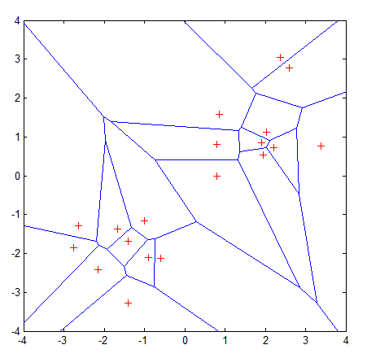
Voronoi Diagram
Properties:
All possible points within a sample's Voronoi cell are the nearest neighboring points for that sample
For any sample, the nearest sample is determined by the closest Voronoi cell edge

Slide 12
Distance-weighted k-NN
Replace by:
General Kernel functions like Parzen Windows may be considered
Instead of inverse distance.

Slide 13
Predicting Continuous Values
Replace by:
Note: unweighted corresponds to w_{i}=1 for all i

Slide 14
Nearest-Neighbor Classifiers: Issues
The value of k, the number of nearest neighbors to retrieve
Choice of Distance Metric to compute distance between records
Computational complexity
Size of training set
Dimension of data

Slide 15
Value of K
Choosing the value of k:
If k is too small, sensitive to noise points
If k is too large, neighborhood may include points from other classes
Rule of thumb:
K = sqrt(N)
N: number of training points

Slide 16
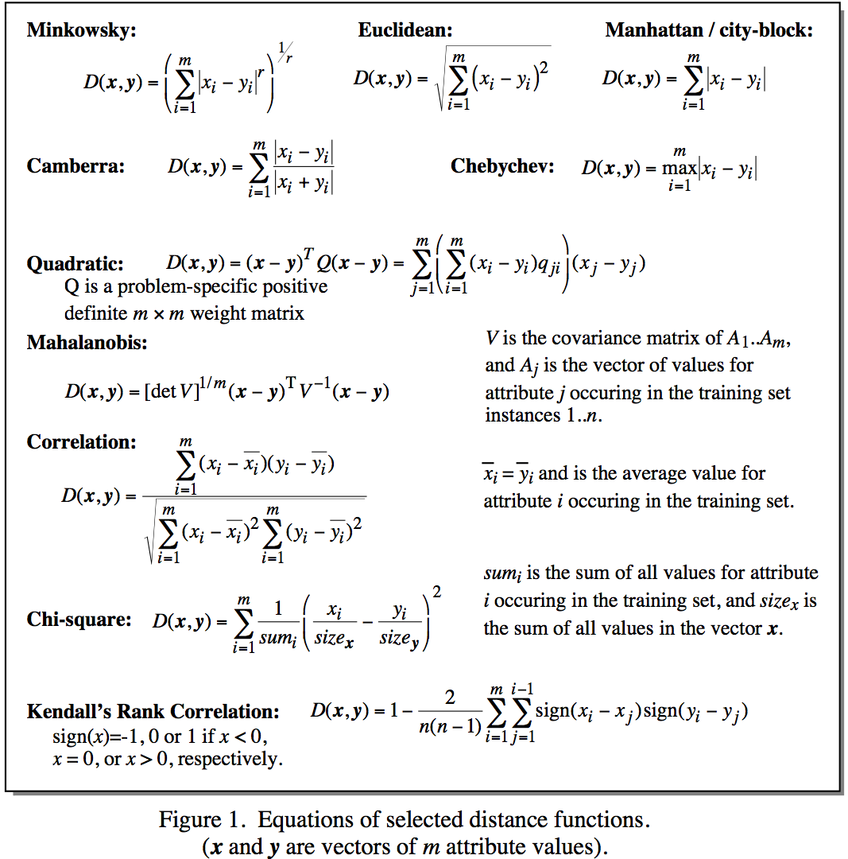
Distance Metrics
Notes:
Minkowsky = l-norm

Slide 17
Distance Measure: Scale Effects
Different features may have different measurement scales
E.g., patient weight in kg (range [50,200]) vs. blood protein values in ng/dL (range [-3,3])
Consequences
Patient weight will have a much greater influence on the distance between samples
May bias the performance of the classifier

Slide 18
Standardization
Transform raw feature values into z-scores
is the value for the i^{th} sample and j^{th} feature
is the average of all for feature j
is the standard deviation of all over all input samples
Range and scale of z-scores should be similar (providing distributions of raw feature values are alike)

Slide 19
Nearest Neighbor : Dimensionality
Problem with Euclidean measure:
High dimensional data
curse of dimensionality
Can produce counter-intuitive results
Shrinking density – sparsification effect
1 1 1 1 1 1 1 1 1 1 1 0
1 0 0 0 0 0 0 0 0 0 0 0
vs
0 1 1 1 1 1 1 1 1 1 1 1
0 0 0 0 0 0 0 0 0 0 0 1
d = 1.4142
d = 1.4142

Slide 20
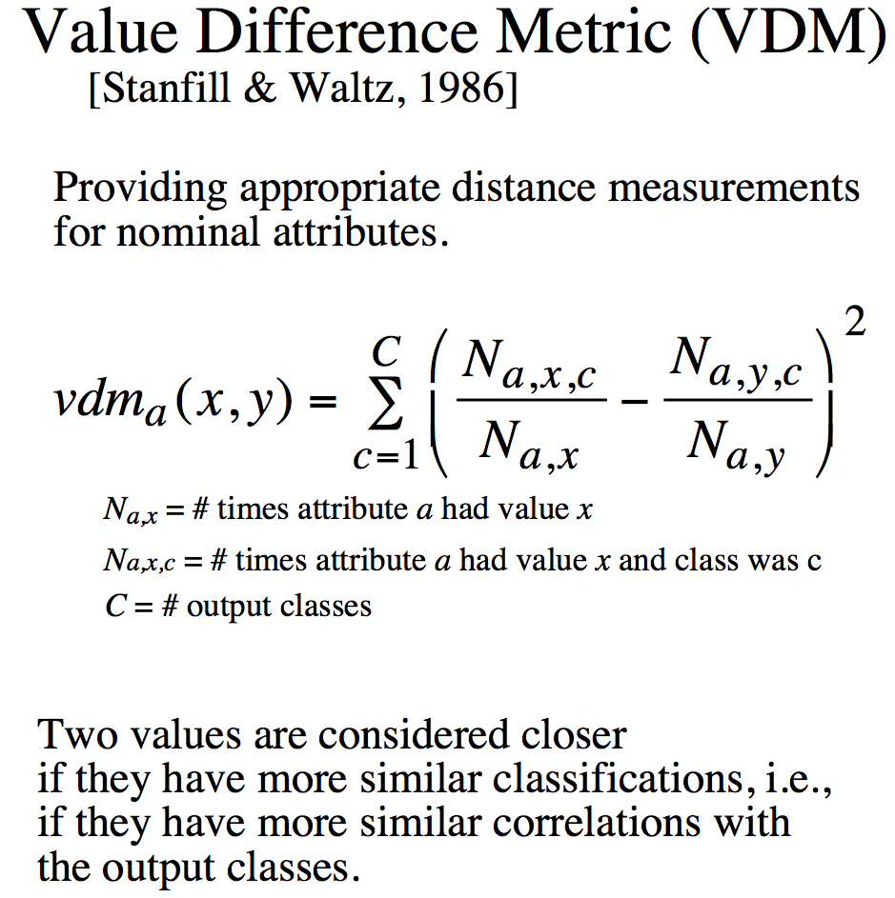
Distance for Nominal Attributes
Notes:
Do a single example here. Shape (Round, Square) 6/10 and 3/5

Slide 21
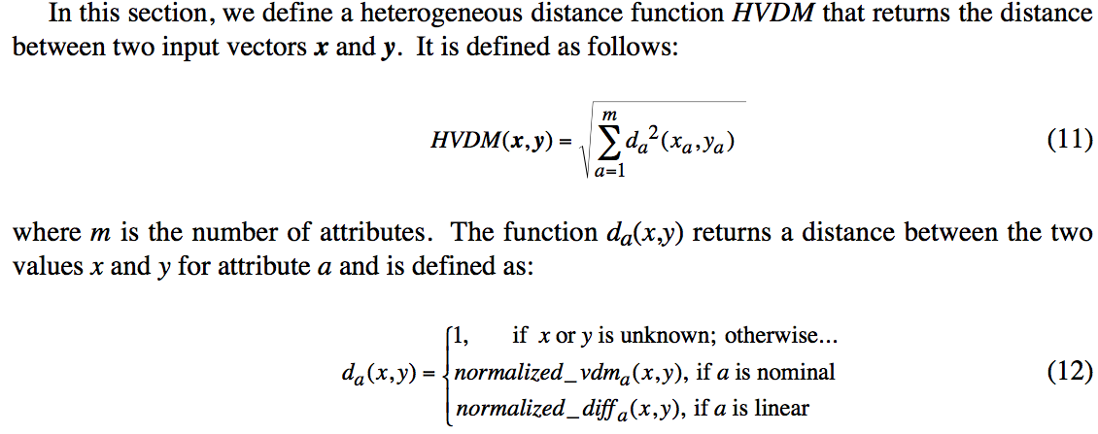
Distance for Heterogeneous Data
Wilson, D. R. and Martinez, T. R., Improved Heterogeneous Distance Functions, Journal of Artificial Intelligence Research, vol. 6, no. 1, pp. 1-34, 1997

Slide 22
Nearest Neighbour : Computational Complexity
Expensive
To determine the nearest neighbour of a query point q, must compute the distance to all N training examples
Pre-sort training examples into fast data structures (kd-trees)
Compute only an approximate distance (LSH)
Remove redundant data (condensing)
Storage Requirements
Must store all training data P
Remove redundant data (condensing)
Pre-sorting often increases the storage requirements
High Dimensional Data
“Curse of Dimensionality”
Required amount of training data increases exponentially with dimension
Computational cost also increases dramatically
Partitioning techniques degrade to linear search in high dimension

Slide 23
Reduction in Computational Complexity
Reduce size of training set
Condensation, editing
Use geometric data structure for high dimensional search

Slide 24
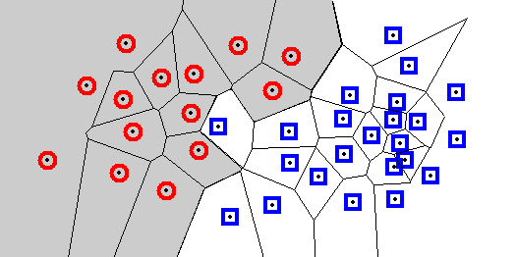
Condensation: Decision Regions
Each cell contains one sample, and every location within the cell is closer to that sample than to any other sample.
A Voronoi diagram divides the space into such cells.
Every query point will be assigned the classification of the sample within that cell. The decision boundary separates the class regions based on the 1-NN decision rule.
Knowledge of this boundary is sufficient to classify new points.
The boundary itself is rarely computed; many algorithms seek to retain only those points necessary to generate an identical boundary.

Slide 25
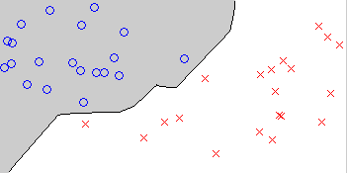
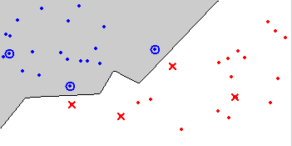
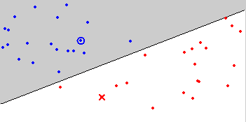
Condensing
Aim is to reduce the number of training samples
Retain only the samples that are needed to define the decision boundary
Decision Boundary Consistent – a subset whose nearest neighbour decision boundary is identical to the boundary of the entire training set
Minimum Consistent Set – the smallest subset of the training data that correctly classifies all of the original training data
Original data
Condensed data
Minimum Consistent Set

Slide 26
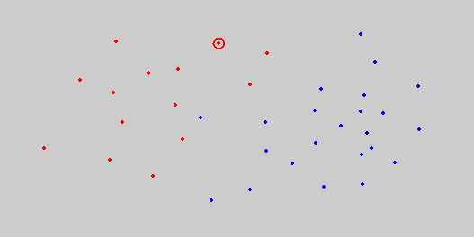
Condensing
Condensed Nearest Neighbour (CNN)
Incremental
Order dependent
Neither minimal nor decision boundary consistent
O(n³) for brute-force method
Initialize subset with a single (or K) training example
Classify all remaining samples using the subset, and transfer any incorrectly classified samples to the subset
Return to 2 until no transfers occurred or the subset is full

Slide 27
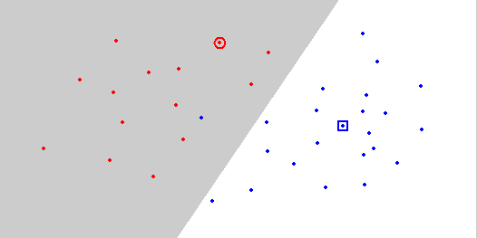
Condensing
Condensed Nearest Neighbour (CNN)
Initialize subset with a single training example
Classify all remaining samples using the subset, and transfer any incorrectly classified samples to the subset
Return to 2 until no transfers occurred or the subset is full

Slide 28
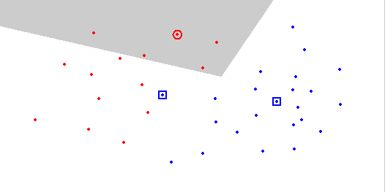
Condensing
Condensed Nearest Neighbour (CNN)
Initialize subset with a single training example
Classify all remaining samples using the subset, and transfer any incorrectly classified samples to the subset
Return to 2 until no transfers occurred or the subset is full

Slide 29
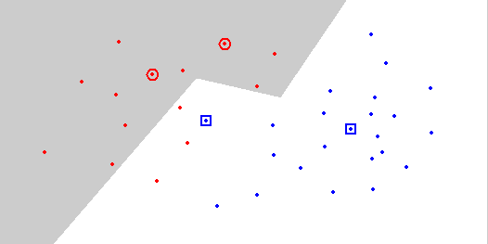
Condensing
Condensed Nearest Neighbour (CNN)
Initialize subset with a single training example
Classify all remaining samples using the subset, and transfer any incorrectly classified samples to the subset
Return to 2 until no transfers occurred or the subset is full

Slide 30
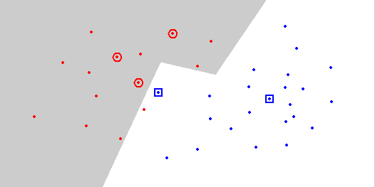
Condensing
Condensed Nearest Neighbour (CNN)
Initialize subset with a single training example
Classify all remaining samples using the subset, and transfer any incorrectly classified samples to the subset
Return to 2 until no transfers occurred or the subset is full

Slide 31
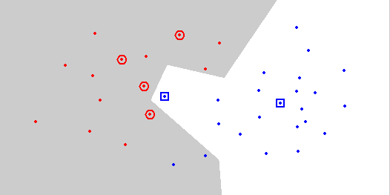
Condensing
Condensed Nearest Neighbour (CNN)
Initialize subset with a single training example
Classify all remaining samples using the subset, and transfer any incorrectly classified samples to the subset
Return to 2 until no transfers occurred or the subset is full

Slide 32
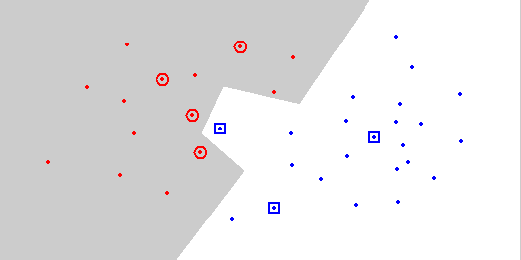
Condensing
Condensed Nearest Neighbour (CNN)
Initialize subset with a single training example
Classify all remaining samples using the subset, and transfer any incorrectly classified samples to the subset
Return to 2 until no transfers occurred or the subset is full

Slide 33
High dimensional search
Given a point set and a nearest neighbor query point
Find the points enclosed in a rectangle (range) around the query
Perform linear search for nearest neighbor only in the rectangle
Query

Slide 34
kd-tree: data structure for range search
Index data into a tree
Search on the tree
Tree construction: At each level we use a different dimension to split
x=5
x<5
x>=5
C
B
y=3
y=6
A
E
D
x=6

Slide 35
kd-tree example
X=3
X=7
X=5
y=6
y=5
Y=6
x=8
x=7
x=3
y=2
Y=2
X=5
X=8

Slide 36
KNN: Alternate Terminologies
Instance Based Learning
Lazy Learning
Case Based Reasoning
Exemplar Based Learning

